Slide 1


Machine Learning Unsupervised
Muhammad Angga Muttaqien
CEO & Research Lead
Indonesia AI (PT. Teknologi Artifisial Indonesia)
Notes:
Describe yourself
Title + Outline
Non-technical material

Slide 2
Introduction to Essential Math
Notes:
Describe yourself
Title + Outline
Non-technical material

Slide 3

Matrix Operation
The way math and science helps us humans to quantify and describe the world around us, the world that has multi-dimensional properties.
Scalar is a quantity having only magnitude and no direction (speed). Vector is a quantity having both magnitude and direction (velocity). Mathematically, a scalar, vector, matrix, all are a tensor.

Slide 4
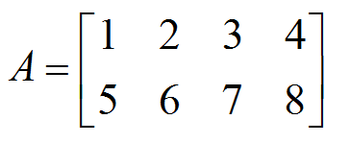
Matrix Operation
In 1985 Arthur Cayley presented the system of matrices called Theory of matrices. It was the latest way to solve the system of linear equation. It is undoubtedly the most powerful tool in mathematics. It is being used in various science as well as a business field like budgeting, cost estimation, sales projection, etc. Matrices are also used in machine learning.
A matrix is a rectangular array of numbers or function. The numbers inside the matrix are called the elements or entries. The following are some examples of matrices with order/dimension (2x4):

Slide 5
Matrix Operation (Addition & Subtraction)
Addition between two matrices is feasible if and only if they have the same order or the dimensions that is they must have the same number of rows and columns. Addition if the matrix is feasible by adding the element of another matrix if they have the same order.
Suppose Angga has two shops at places A and B. Each shop sells shoes for men and women in three different price categories, and I want to know the total sales of shoes in each price categories. So, this can be represented in the matrix form. Same applies to subtraction.

Slide 6
Matrix Operation (Dot Product)
The dot product is a fundamental way we can combine two vectors or matrices. Intuitively, it tells us something about how much two vectors point in the same direction.
Formula:
a = [a1, a2, a3]
b = [b1, b2, b3]
a . b = a1b1 + a2b2 + a3b3

Slide 7
Matrix Operation (Cross Product)
Like the dot product, the cross product is an operation between two vectors but not in the same direction.
When we compare the dot product and the cross product, there are three main differences.
The dot product returns a number, but the cross product returns a vector
The dot product works in any number of dimensions, but the cross product only works in 3D
The dot product measures how much two vectors point in the same direction, but the cross product measures how much two vectors point in different directions
Formula:
a = [a1, a2, a3]
b = [b1, b2, b3]
a x b = [a2b3 - a3b2, a3b1 - a1b3, a1b2 - a2b1]

Slide 8
Statistics
Measures of Central Tendency
Mean
Median
Mode
Measures of Spread
Range
Quartile (Q) & Interquartile Range (IQR)
Variance
Standard Deviation

Slide 9
Statistics (Central Tendency)
Mean Mean is the sum of all the values divided by the number of values
Median Median is middle value of numerical data which has been sorted.
Mode Mode is the most frequent value in a range of values. It used when the data is considered as categorical or numeric which can be treated as equal.

Slide 10
Statistics (Measures of Spread)
Range
Range explains numerical measure of the difference between the largest value and the smallest value, is the simplest measure of variability in the data.
Quartile and Interquartile Range (IQR) A quartile is a group of values and/or means that divide a data set into quarters, or groups of four. The interquartile range is a value that is the difference between the upper quartile value and the lower quartile value.
Variance & Standard Deviation
Variance is a measure of dispersion that takes into account the spread of all data points in a data set. It’s the measure of dispersion the most often used, along with the standard deviation, which is simply the square root of the variance.

Slide 11
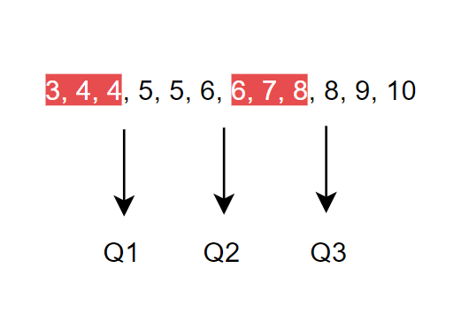
Statistics (Measures of Spread)
Easiest way To find the quartiles of data, we can use the following steps:
A. Order the data from least to greatest B. Find the median of the data set and divide the data set into two halves C. Find the median of the two halves As for IQR is the subtraction between Third quartile(Q3) and First quartile(Q1). So that we can get the lower and upper bound value. Lower Bound = Q1 - 1.5 * IQR Upper Bound = Q3 + 1.5 * IQR If there’s a value outside its lower / upper bound its called outlier

Slide 12
Statistics (Measures of Spread)
Example: Let’s calculate the variance of the follow data set: 2, 7, 3, 12, 9.
The first step is to calculate the mean. The sum is 33 and there are 5 data points. Therefore, the mean is 33 ÷ 5 = 6.6.
Then you take each value in data set, subtract the mean and square the difference. For instance, for the first value: (2 - 6.6)² = 21.16 The squared differences for all values are added: 21.16 + 0.16 + 12.96 + 29.16 + 5.76 = 69.20 The sum is then divided by the number of data points: 69.20 ÷5 = 13.84 (variance), 3.72 (standard deviation).

Slide 13
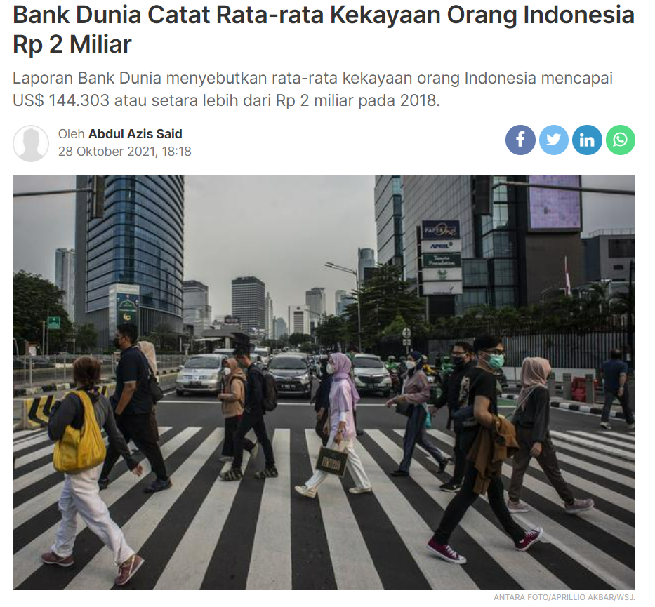
Statistics (Measures of Spread)

Slide 14
Data Preprocessing
Notes:
Describe yourself
Title + Outline
Non-technical material

Slide 15

What is Data Processing?
In any Machine Learning process, Data Preprocessing is that step in which the data gets transformed, or Encoded, to bring it to such a state that now the machine can easily parse it. In other words, the features of the data can now be easily interpreted by the algorithm.

Slide 16
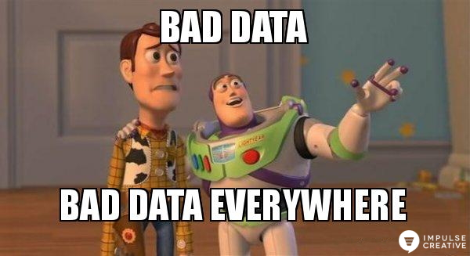
Why Data Processing?
Data in the real world is so dirty.
Incomplete: lacking attribute values
Noisy: Containing errors or outlier
Categorical or Continuous: Data represents categorical or continuous values that are not standardized

Slide 17
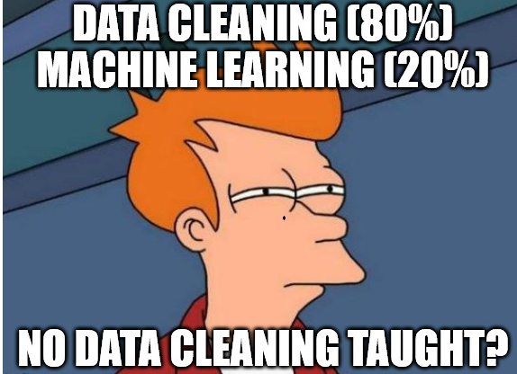
Data Cleaning
What we will do in the data cleaning:
Fill in missing values
Eliminate noise data
Identify or remove outliers
Deal with inconsistencies

Slide 18

Data Transformation
Data transformation is the process of converting data from one format or structure into another format or structure.
Purpose :
To transform data into form that can be learned easier by computer
To simplify data by decreasing its value scale
To standardize data type (categorical or numerical)

Slide 19
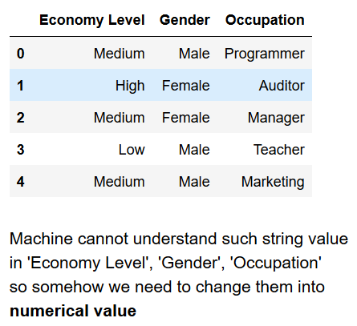
Data Transformation (Categorical)
The idea is to make all features that contain categorical data for having numerical information. Generally there are 2 methods that can be used:
Label Encoder
One Hot Encoder

Slide 20
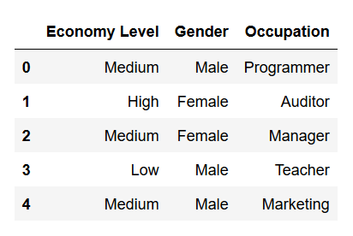
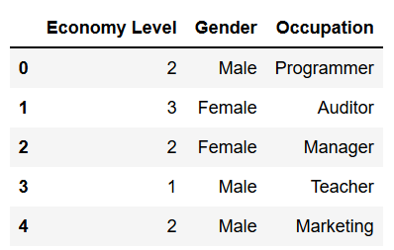
Data Transformation (Categorical)
Label Encoder

Slide 21
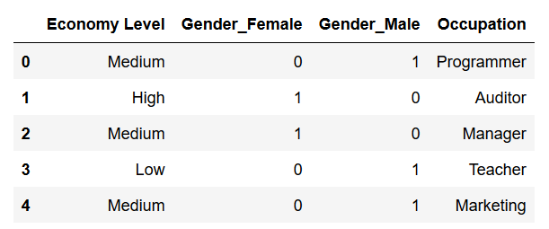
Data Transformation (Categorical)
One Hot Encoder

Slide 22
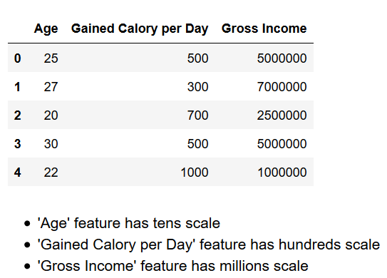
Data Transformation (Numerical)
The idea is to make all feature that contain numerical data for having same scale. Generally there are 2 methods that can be used:
Standard Scaler
Min-Max Scaler

Slide 23
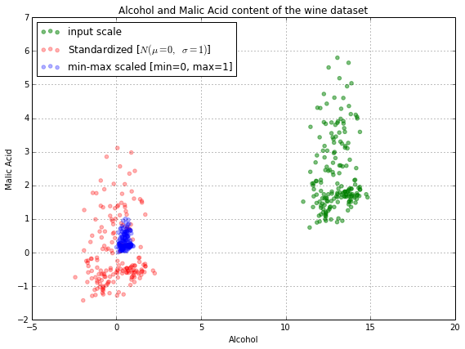
Data Transformation (Numerical)
Standard Scaler transform data distribution into normal distribution
Min Max Scaler transform data range into 0 ~ 1
Rule of thumb:
Use Min Max Scaler as the default if you are transforming a feature
Use Standard Scaler if you need a relatively normal distribution

Slide 24
Feature Selection
Feature Selection | Feature Engineering | Feature Extraction
Based on domain knowledge Exclude unnecessary features Heatmap and many other visualization techniques support | Based on domain knowledge Generating new feature from other related datasets | Keep all information from all feature before extracting the information Popular techniques such as Principal Component Analysis (PCA), Linear Discriminant Analysis (LDA) and Auto Encoder (Neural Network Approach)

Slide 25
Introduction to Machine Learning
Notes:
Describe yourself
Title + Outline
Non-technical material

Slide 26

What is ML

Slide 27
What is ML
Machine Learning Algorithms
Support Vector Machine
Bayesian Network
Logistic Regression
K-Nearest Neighbour
Naive Bayes
Decision Tree
K-Means
Linear Regression
Artificial Neural Network
Random Forest
Perceptron

Slide 28
What is ML
Deep Learning Algorithms
Deep Fully Neural Network
Convolutional Neural Network
Recurrent Neural Network
Deep Boltzmann Machine
YOLO
Single-Shot Detector
Fully Convolutional Network
Deep Belief Network
Deep Reinforcement Learning
Auto-Encoders
U-Net

Slide 29
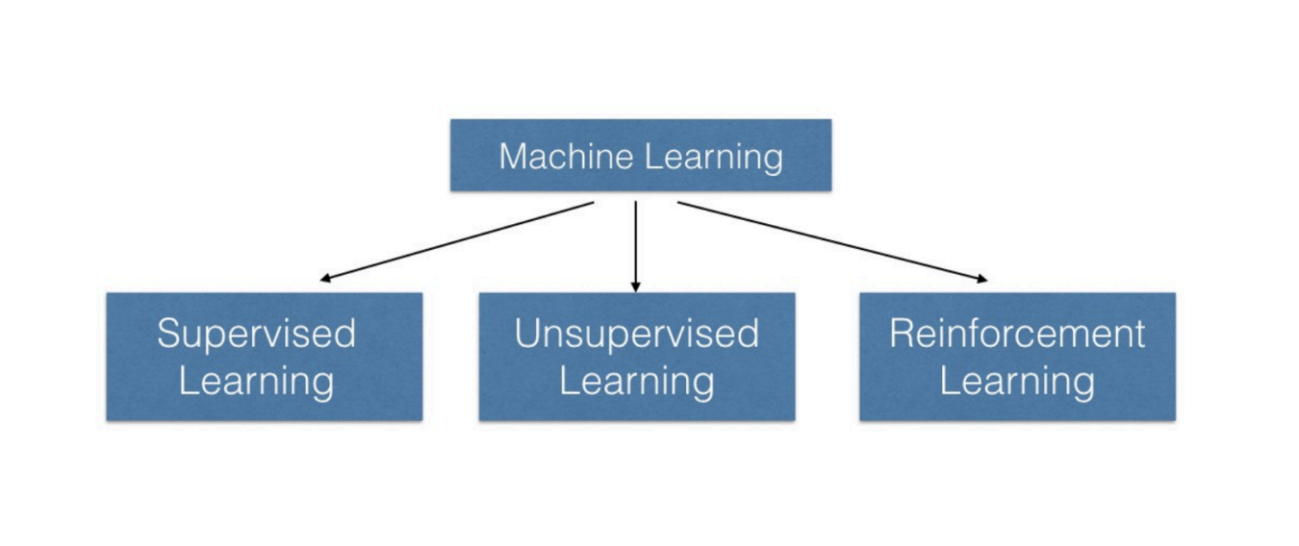
Type of ML

Slide 30
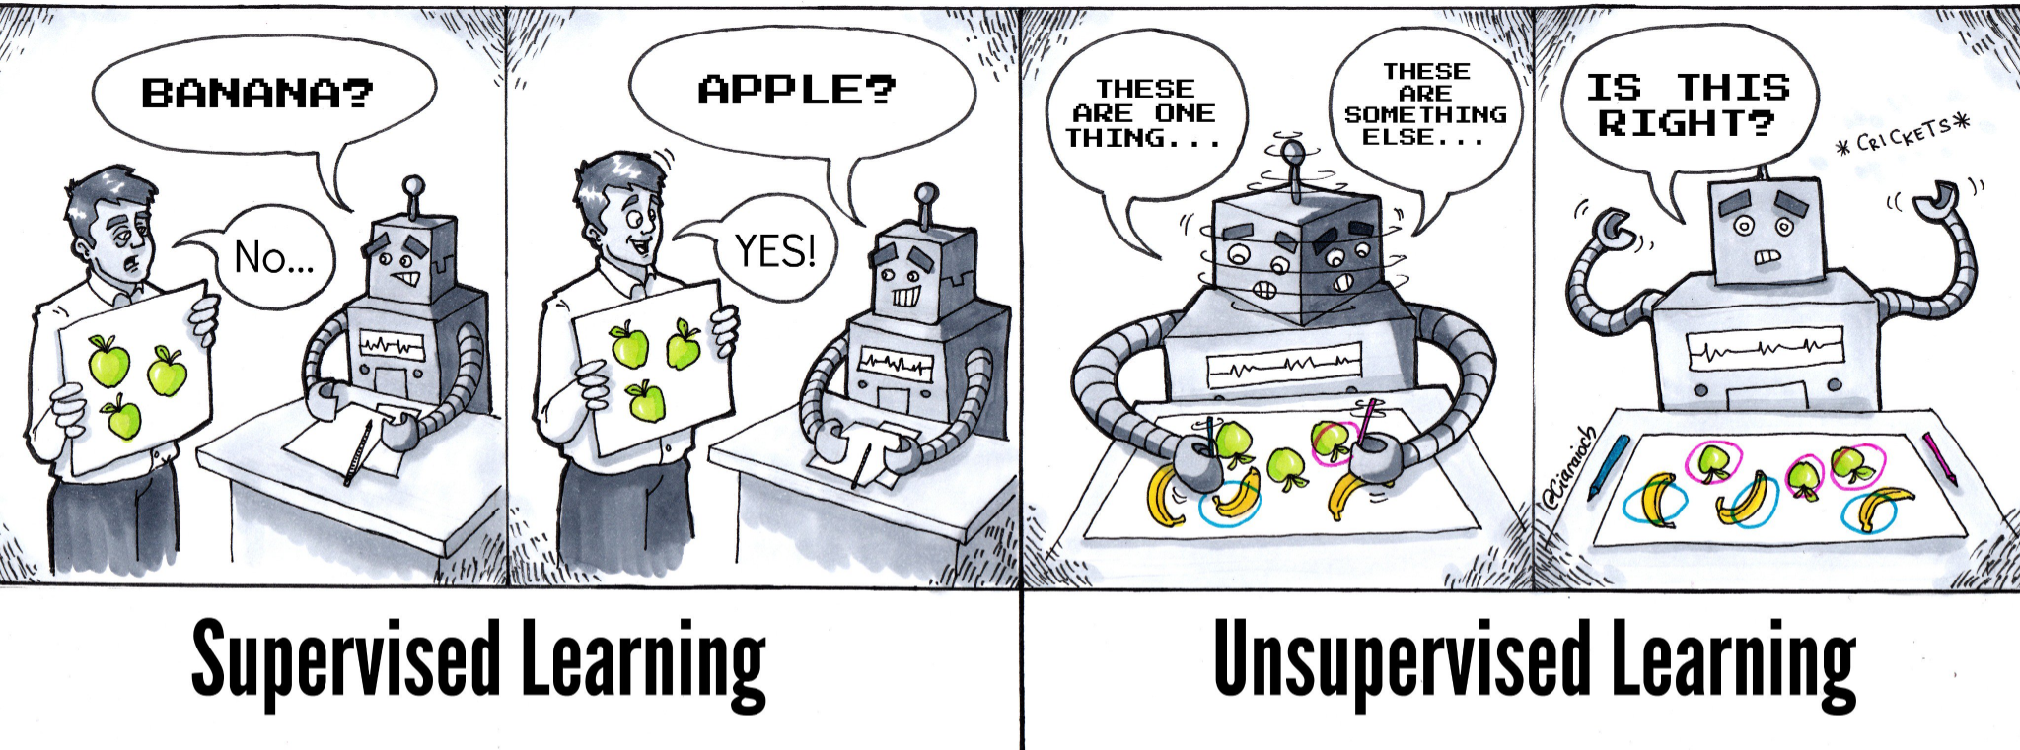
Type of ML

Slide 31
Supervised Algorithms
Notes:
Describe yourself
Title + Outline
Non-technical material

Slide 32
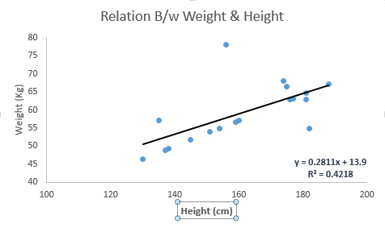
Linear Regression
Linear regression is usually among the first few topics which people pick while learning predictive modelling
In this technique:
The dependent variable is continuous
Nature of regression line is linear
Now, the question is “How do we obtain best fit line?”
Weight (Kg)
Height (cm)

Slide 33
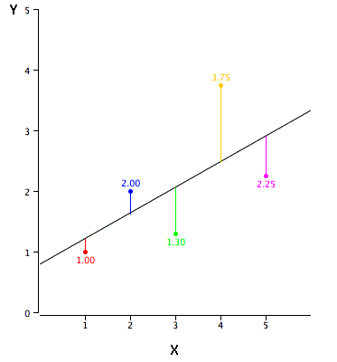
Linear Regression
How to obtain best fit line (value of a and b)?
This task can be easily accomplished by Least Square Method & Gradient Discent
We can evaluate the model performance using the metric R-square

Slide 34
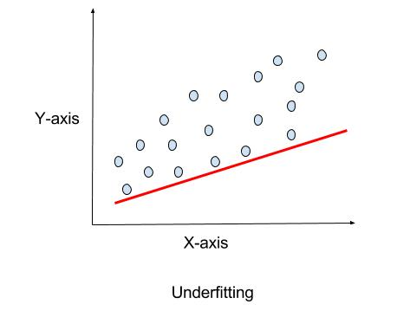
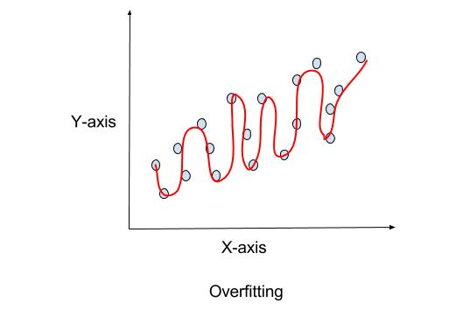
Linear Regression
The model should fit to the datapoint with the most less error
No underfitting, no overfitting

Slide 35
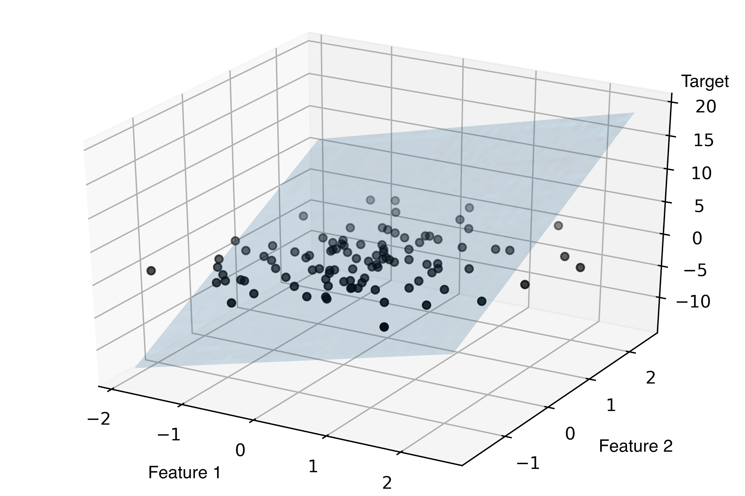
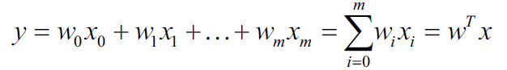
Linear Regression
Simple linear regression: one-to-one relationship between the input variable and the output variable
Multiple linear regression: many-to-one relationship, instead of just using one input variable, you use several

Slide 36
Linear Regression
Pros:
Easy to understand
Easy to implement and achieve good scores
The ability to identify outliers or anomalies
Cons:
Linear regression is limited to linear relationships
Linear regression is sensitive to outliers

Slide 37
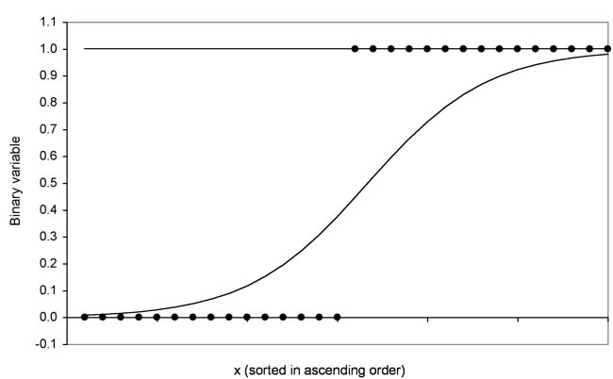
Logistic Regression
It is not a regression model
Logistic regression predicts the probability of occurrences of an event by fitting data to a logit function by using sigmoid function

Slide 38
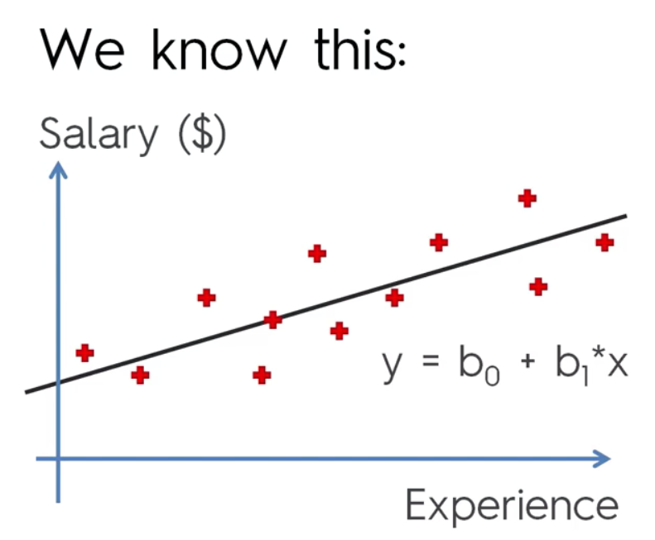
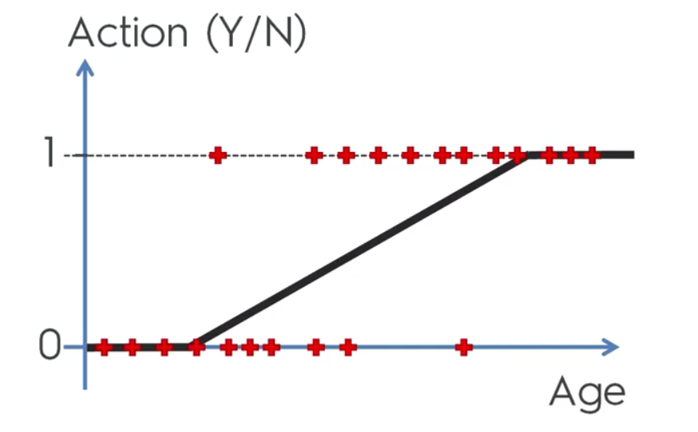
Logistic Regression
Why not use Linear Regression algorithm?
Regression vs Classification

Slide 39
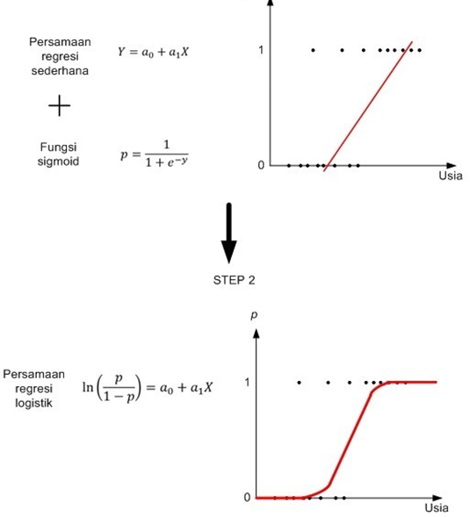
Logistic Regression
Apply sigmoid function to logistic regression.
Think of it as probabilities!

Slide 40
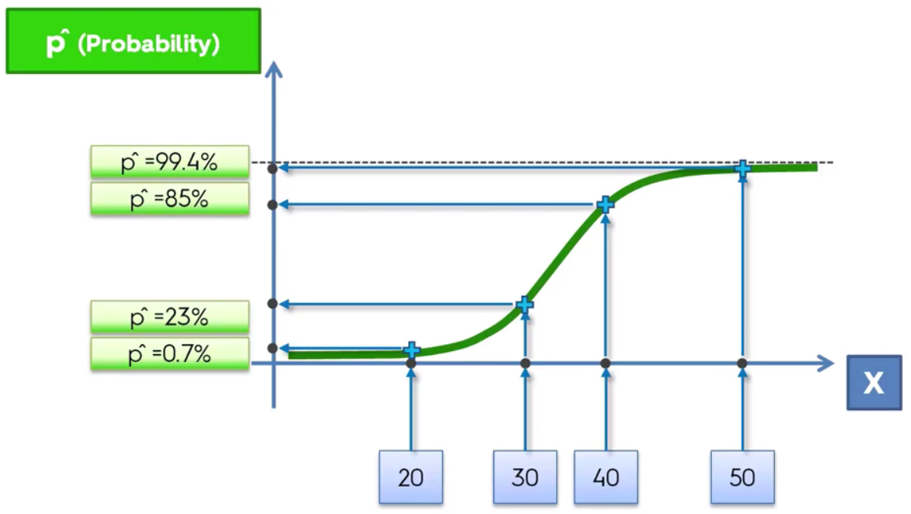
Logistic Regression
Logistic regression seen from probabilities point of view.

Slide 41
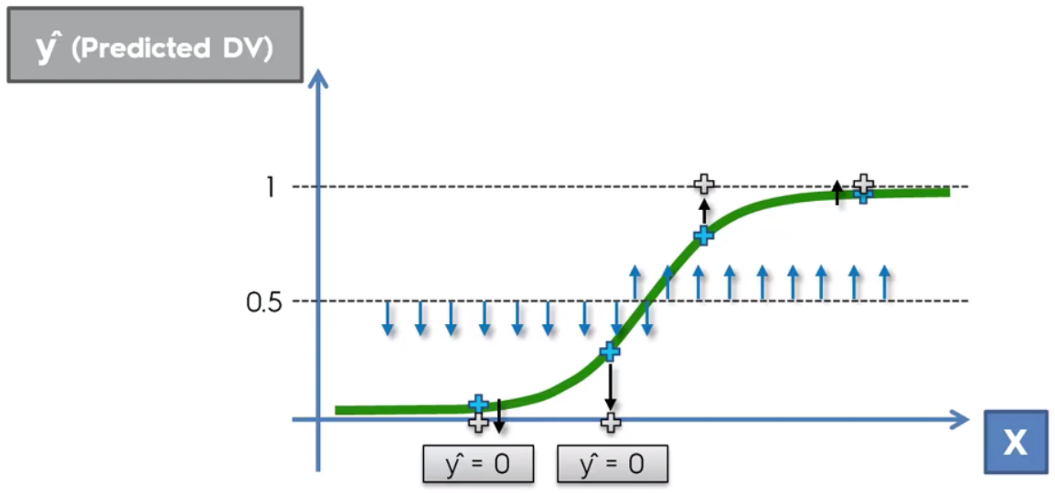
Logistic Regression
Threshold determine whether one data is considered as one class or the other
This is the fundamental concept of Deep Learning

Slide 42

Decision Tree & Random Forest
The general method of random decision forest was first proposed by Ho in 1995, Tin Kam Ho
It is an ensemble method, meaning that a random forest model is made up of a large number of small decision trees, called estimators, which each produce their own predictions
The random forest model combines the predictions of the estimators to produce a more accurate prediction

Slide 43
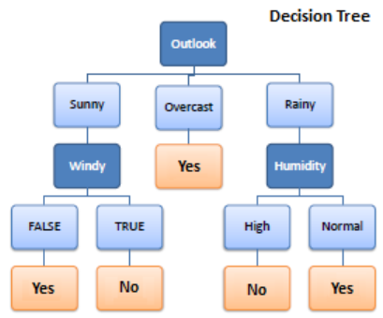
Decision Tree & Random Forest
Decision Tree is the key concept of Random Forest
Consider this example: What are the factors which decide if we are going to play golf?
Outlook? (Sunny, Overcast, Rainy)
Temperature? (Hot, Mild, Cool)
Humidity? (High, Normal)
Windy? (False, True)
Label: Play Golf? (Yes / No)

Slide 44
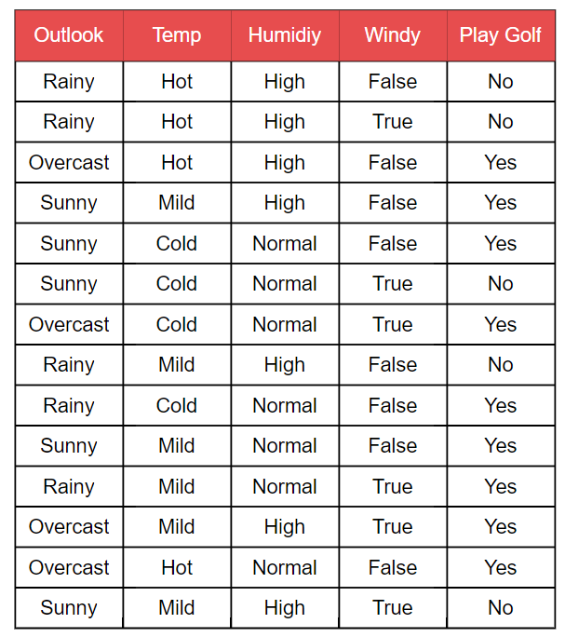
Decision Tree & Random Forest
Predictors: Outlook, Temp, Humidity, Windy, Play Golf
Target: Play Golf

Slide 45
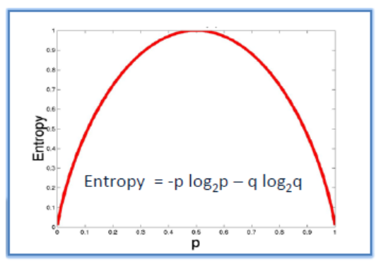
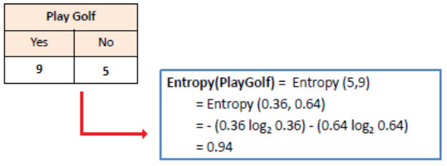
Decision Tree & Random Forest
We are going to use some points deducted from information theory.
To measure the randomness or uncertainty of a variable X (feature) is defined by Entropy.
Find the entropy of the target feature:
If all examples are positive or all are negative then entropy = 0
If all examples are equally divided then entropy = 1

Slide 46
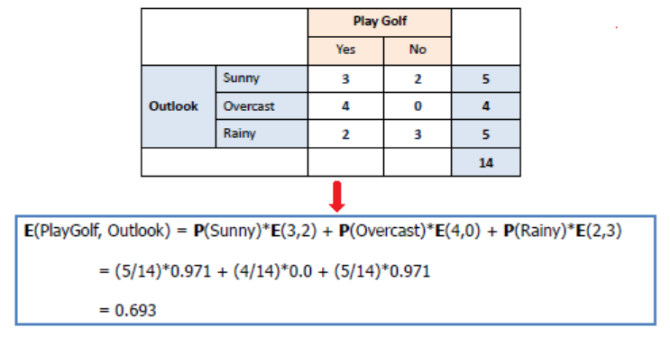
Decision Tree & Random Forest
Find the entropy of each feature towards the target.

Slide 47
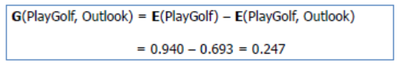
Decision Tree & Random Forest
Find the information gain of each feature used to predict the target.
Information gain: Decrease of entropy after the dataset is split on an attribute
Creating decision tree classification is about finding attribute that return the highest Information Gain

Slide 48
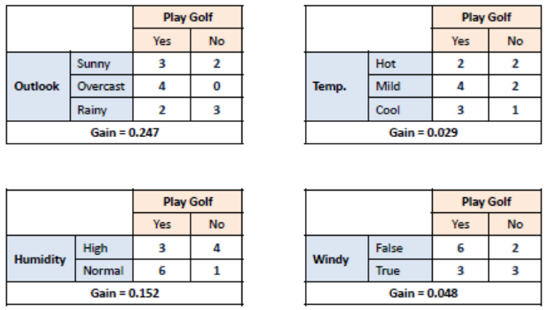
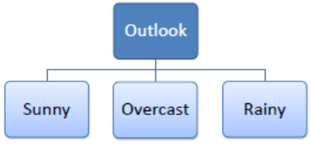
Decision Tree & Random Forest
Select feature with the highest Information Gain as the root node.

Slide 49
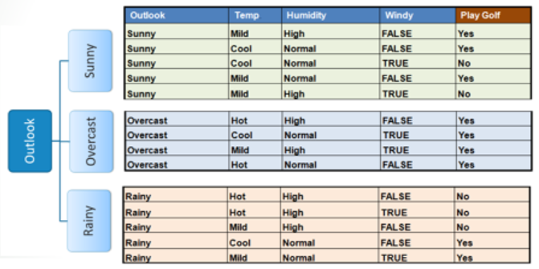
Decision Tree & Random Forest
Select feature with the highest Information Gain as the root node.

Slide 50
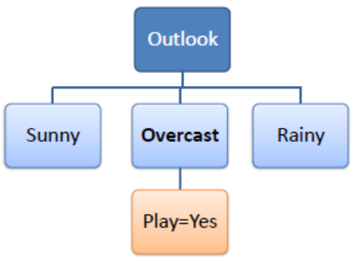
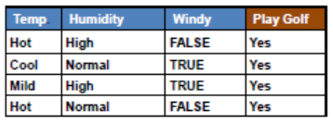
Decision Tree & Random Forest
If all examples are positive (yes) or all are negative (no) then entropy will be zero, in this case it is overcast.
Branch with entropy is 0 will be a terminal node (leaf).

Slide 51
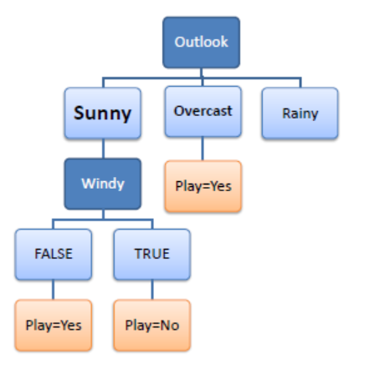
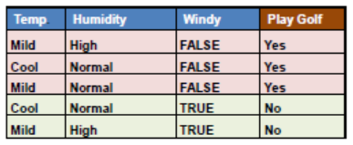
Decision Tree & Random Forest
Branch with entropy more than 0 needs further splitting.

Slide 52
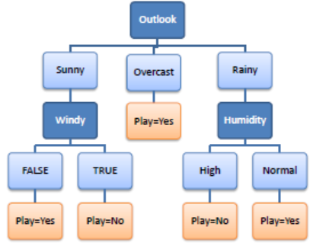
Decision Tree & Random Forest
Decision tree algorithm is run recursively on the non-leaf branches, until all data is classified.

Slide 53
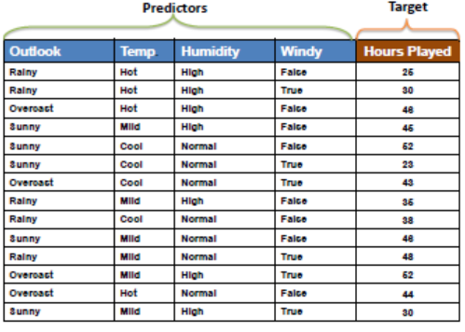
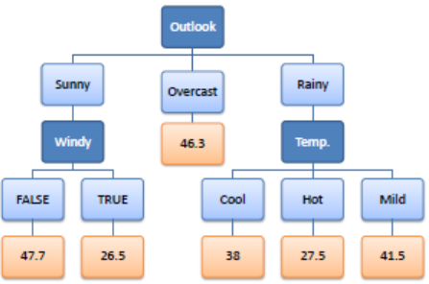
Decision Tree & Random Forest
While using information Gain as a criterion, we assume target attributes to be categorical, and for gini index, target attributes are assumed to be continuous.

Slide 54
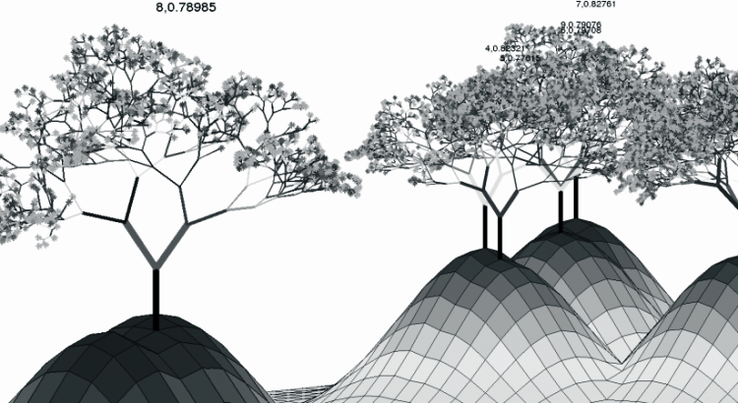
Decision Tree & Random Forest
Random forests or random decision forests are an ensemble learning method for classification, regression and other tasks that operates by constructing multiple decision tree
The classification forest chooses the result with most votes overall trees (max voting)
The regression forest average outputs of different trees (average voting)
Ensemble learning is a popular machine learning technique that combines several models to improve overall result (in this case, combines several trees)

Slide 55
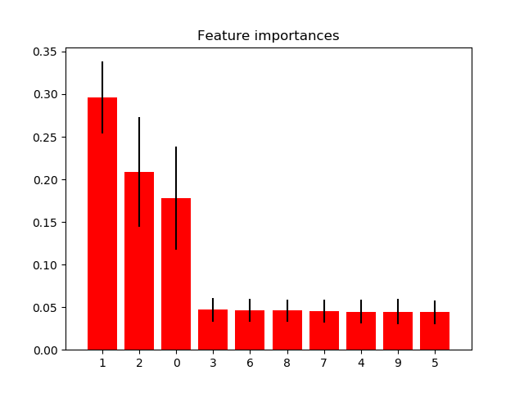
Decision Tree & Random Forest
Shows the use of forests of trees to evaluate the importance of features on an artificial classification task. The red bars are the feature importances of the forest, along with their inter-trees variability.
As expected, the plot suggests that 3 features are informative, while the remaining are not.

Slide 56
Decision Tree & Random Forest
Features used at the top of the tree contribute to the final prediction decision of a larger fraction of the input samples
Feature ranking: 1. feature 1 (0.295902) 2. feature 2 (0.208351) 3. feature 0 (0.177632) 4. feature 3 (0.047121) 5. feature 6 (0.046303) 6. feature 8 (0.046013) 7. feature 7 (0.045575) 8. feature 4 (0.044614) 9. feature 9 (0.044577) 10. feature 5 (0.043912)

Slide 57
Decision Tree & Random Forest
Why Random Forest?
Random forest algorithm is suitable for both classifications and regression task
It gives robust accuracy, meaning that it is not so fragile that will drop when tested with testing data
Random forest classifier can handle the missing values and maintain the accuracy of a large proportion of data
Random Forest will be used as baseline model for any kind of project in Industry

Slide 58
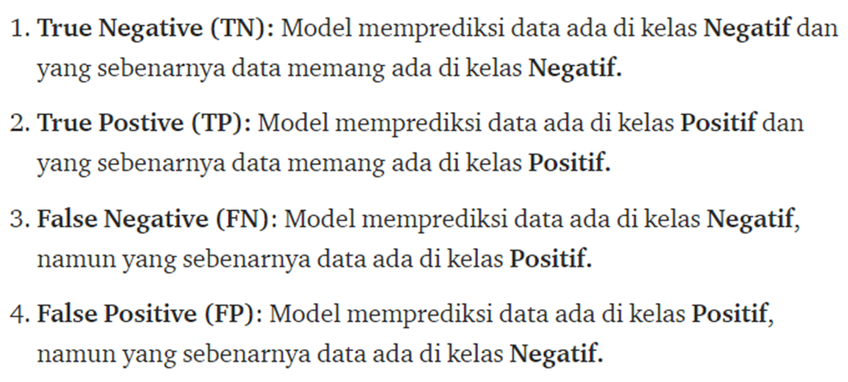
Model Evaluation
Just building a machine learning model is not enough, we need to know how well our model is working. Of course, with a measure (or the term that is often used is metric).
Predicted
TP | FP
FN | TP
Actual

Slide 59
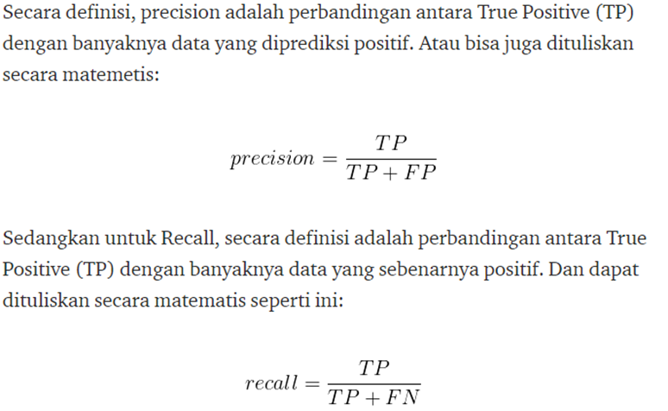
Model Evaluation

Slide 60
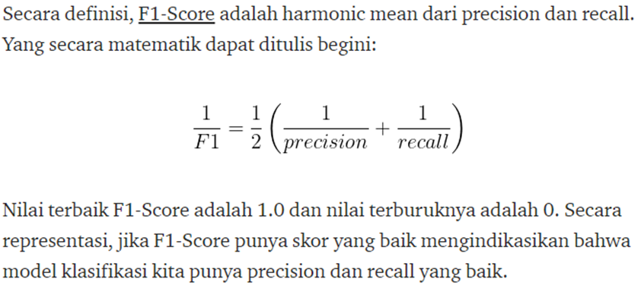
Model Evaluation

Slide 61
Hands-on Now!
Notes:
Describe yourself
Title + Outline
Non-technical material

Slide 62

Hands-on Now!
Here we will try to use datasets regarding marketing campaigns using phone calls of banking institution (finance industry).
The goal of using this datasets is to build smart system that can help to predict if the client will subscribe a term deposit.

